Slide 1
Welcome Back!
Superintendents Conference Day
September 3, 2024

Slide 2
CPTA…Upcoming Events…
9/25-NYSTRS Retirement and Tier 6 Workshop
10/10-GMM Benefits Overview with Brown and Brown and MetLife
10/22 & 10/24-Defensive Driver Classes-(5-8pm)
11/21-CPTA Will Preparation Day-(10:45am-2pm)
2/5-Will Execution Day-(10:45am-2pm)

Slide 3
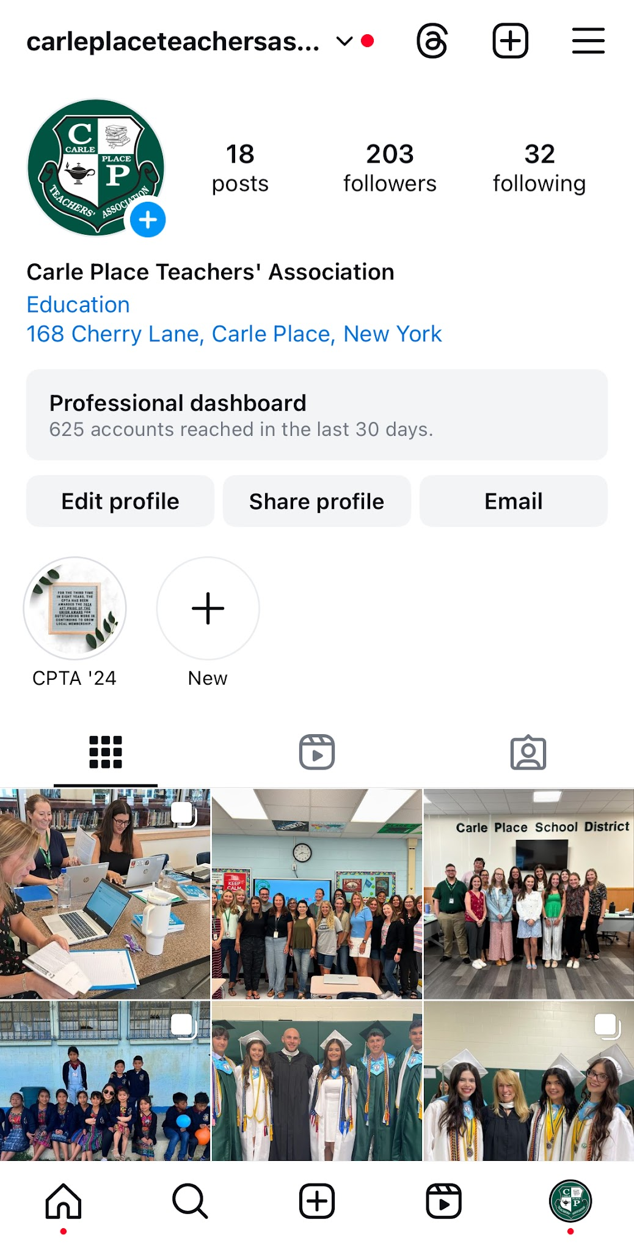
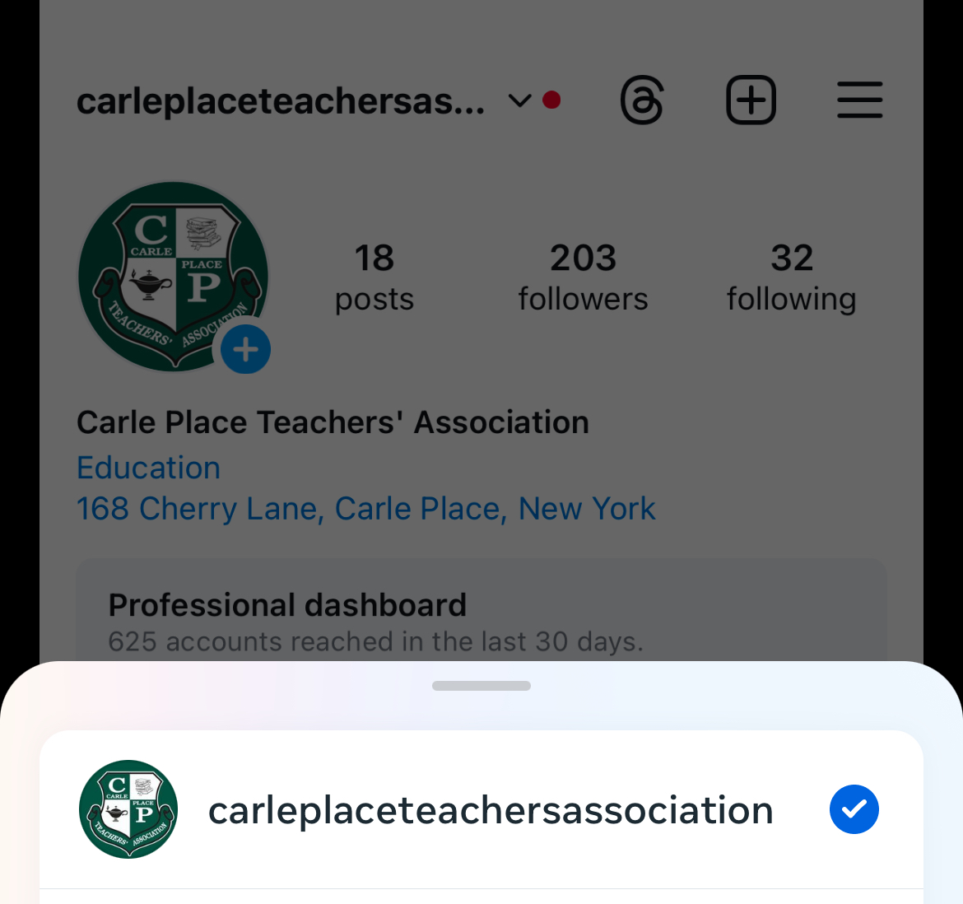

Slide 4
